Slide 1

Handle Azure PostgresQL Auditing With Ease

Slide 2
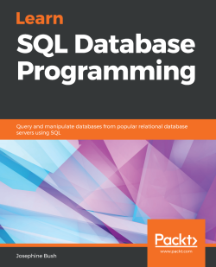





About me
Josephine Bush
10+ years DBA experience MBA IT Management
MS Data Analytics
@hellosqlkitty
sqlkitty.com
Notes:
Hi I’m josehine bush with lots of dba experience in azure, aws, sql server and postgres.

Slide 3

What is auditing?
Collecting and examining information to determine proper use or misuse
Notes:
To start off with what is auditing and why would you want to use it? A lot of people cringe when they hear auditing because they think they are going to get in trouble for doing something wrong. But I think auditing is a good thing. You want to make sure people are following proper procedure. if you don't have proper procedures the auditing can help you figure out what you might want a procedure to look.

Slide 4

Why Audit?
Maybe your company says they don’t value knowing what’s going on in your databases, but….
Notes:
Maybe your company doesn't think it's important to audit, maybe your company is required to audit but you're not sure how to go about it. Even if you're not required. It shouldn't stop you from auditing. I set it up because I got tired of people blaming the database on why something was broken. And then it was a good thing that I prioritized the setup because we were acquired by a heavily regulated company and they need auditing reports that we review on a weekly basis

Slide 5

Problems auditing can solve
Who broke this?
Who changed this?
Who used this?
You can audit pretty much everything anyone does!
Notes:
You’re basically in the dark without auditing. auditing can help you see who changed something and maybe that change is what broke something, maybe a user was set up for one purpose and then it got shared around and everybody's using it now.

Slide 6


Azure POSTGRESQL auditING
Configure pgAudit via the portal
Written to log files by default, or Azure Monitor
No pgAudit in Single Server Basic,
Still in preview on Citus on select server groups
Notes:
To audit azure postgres you can use pgaduit. This will feel very familiar if you use pgaudit on postgres on a vm.
The audit is written to the log files by default or azure monitor. Azure monitor is a very nice option for storing logs longer terms, and querying and reporting on logs in a centralized location.
And note a couple of thing about pgaudit availability

Slide 7
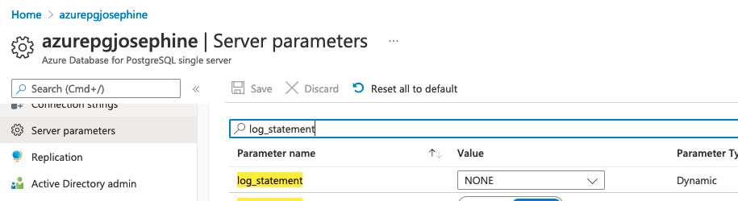
Log_statement parameter
DON’T USE THIS
Leave it set to NONE
This is not part of pgAudit
Notes:
This will turn on a firehose of logging to your log files esp if you choose all. This is not part of pgaudit and I recommend never using this.

Slide 8
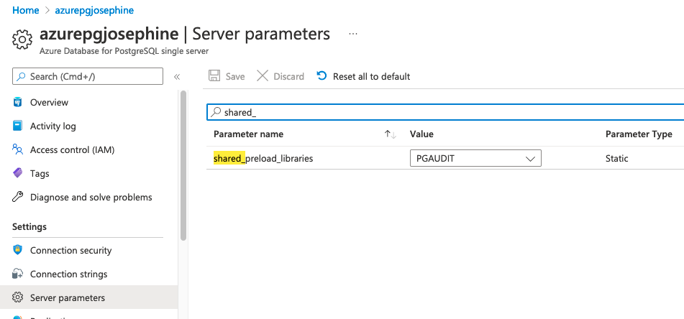
server parameters
Add PGAUDIT to shared_preload_libraries
REQUIRES RESTART to take effect
Notes:
You need start by adding pgaudit to your shared_preload_libraries in the azure portal under server parameters
Then restart

Slide 9
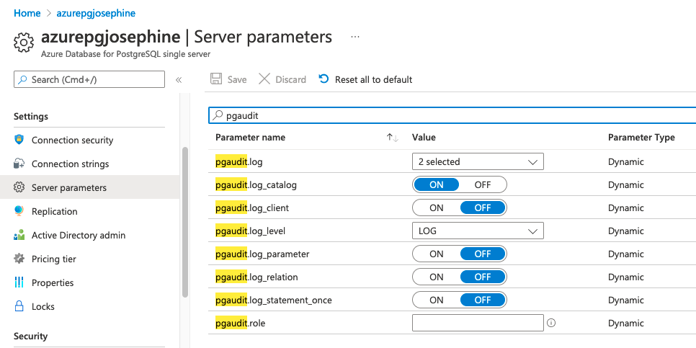
configure pgaudit
Configure pgaudit in server parameters
Notes:
These are the default and recommended settings except the top one pgaudit.log so lets look at that in more detail

Slide 10
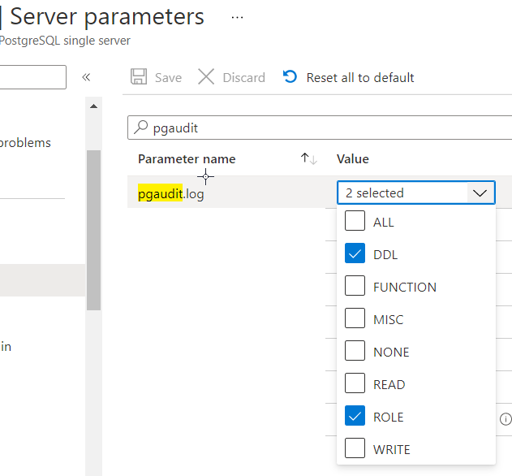
logging actions
pgaudit.log options
ALL DDL FUNCTION MISC NONE READ ROLE WRITE
Notes:
I usually audit only ddl and role bc I want to see changes of that sort for any red flags or issues they may cause
Be careful with read and write
Make sure you don’t audit too much bc it will fill up your log files or make it impossible to find anything in there like drinking from a fire hose

Slide 11
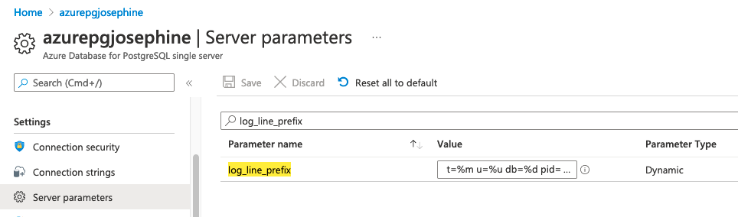
LOG_LINE_PREFIx
Configure log_line_prefix to capture user and database information t=%m u=%u db=%d pid=[%p]:
Knowing who did the audited actions is very important!
Notes:
You need to modify log_line_prefix or you won’t know what role executed the audited action and that’s a very important part of auditing
You can also modify it in other ways as well depending on what you need to see

Slide 12
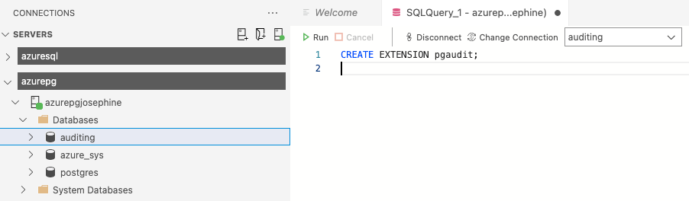
Create extension
CREATE EXTENSION pgaudit;
Execute on each database you want to audit
In client of your choice: psql, pgAdmin, Azure Data Studio

Slide 13
Server logs
New file begins every 1 hour or 100 MB, whichever comes first
Use log_retention_period parameter to change log retention. The default value is 3 days; the maximum value is 7 days
The short-term storage location can hold up to 1 GB of log files, then deleted regardless of retention
Notes:
There is a new file every hour or 100mb
Defailt retention is 3 days but you can change that up to 7
Thing is you need to be aware that if your files are large you can only keep up to 1gb no matter how much time has passed

Slide 14
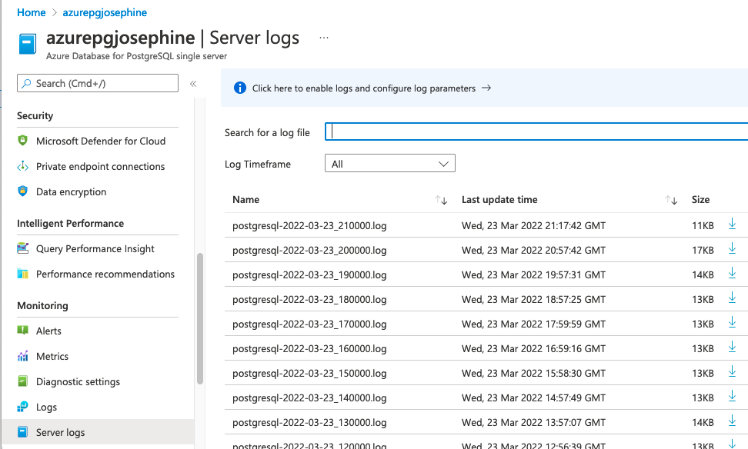
Server logs listing
pgAudit stored in server logs
Notes:
Here’s a sreenshot of where the logs are located under server logs
You need to download them to view them

Slide 15
server log detail
Example pgAudit logging of DDL
t=2022-03-16 20:57:21.276 UTC u=pgadmin db=testing pid=[196]:LOG: AUDIT: SESSION,3,1,DDL,CREATE SCHEMA,SCHEMA,testingauditddl,"CREATE SCHEMA testingauditddl
AUTHORIZATION pgadmin;
",<not logged>
Example pgAudit logging of ROLE
t=2022-03-16 20:57:41.355 UTC u=pgadmin db=testing pid=[200]:LOG: AUDIT: SESSION,1,1,ROLE,CREATE ROLE,,,"CREATE ROLE testingroleauditingagain2 WITH
LOGIN
NOSUPERUSER
INHERIT
CREATEDB
CREATEROLE
NOREPLICATION;",<not logged>
Notes:
Here’s a detailed view of what would be output based on the pgaudit settings I’ve outlined so far.
DDL on the left and role on the right

Slide 16
AZURE monitor
Good option if you want to:
audit a lot of actions
have them in a central location for easier querying/reporting
want longer term storage of data
Configure Azure Monitor diagnostic settings which automatically emits your logs in JSON format
31 days of retention included in price and configurable up to 730 days
Notes:
Azure monitor is really a better option for logging
You can keep more and it’s way easier to query and report on the audit info

Slide 17
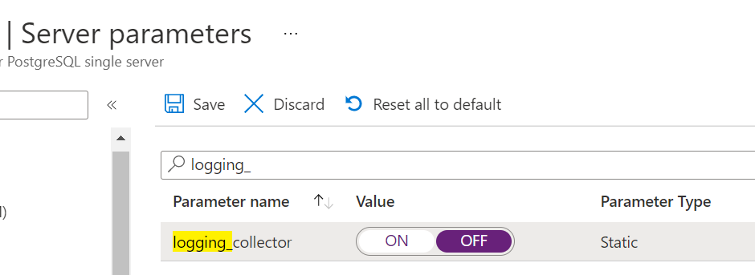
AZURE monitor logging_collector
Recommended to stop generating log files Set logging_collector to OFF
REQUIRES RESTART to take effect
Notes:
It’s best to turn off your logging_collector if you are using azure monitor
This means all your pg logs will be in azure monitor not just the audit logging

Slide 18
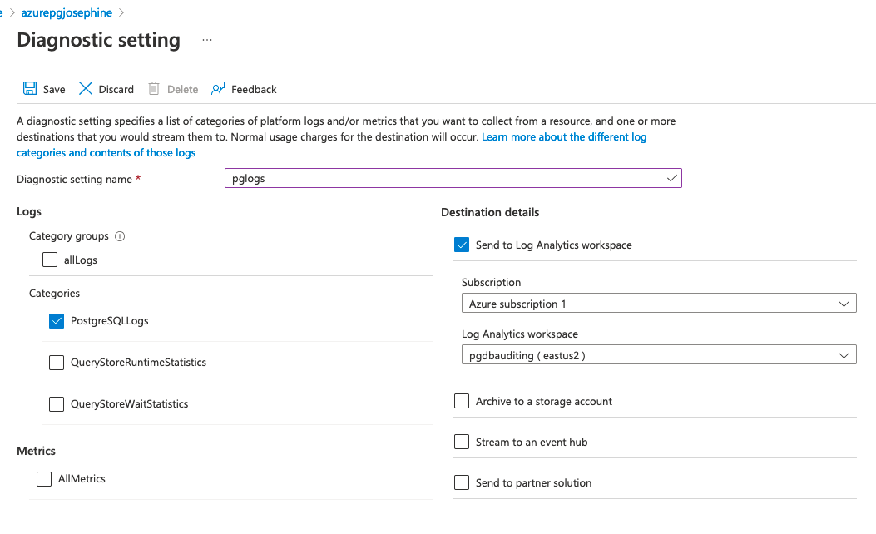
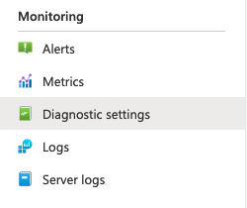
Configure diagnostic settings
Notes:
You will need to configure a diagnostic setting for the logs to get into azure monitor
I put them all in a log analytics workspace but you have some other options depending on what you feel is best.
I find log analytics workspace with kusto query easy to query and report on audit data.

Slide 19
Query AZURE monitor logs
Go to your log analytics workspace
Click Logs and run a Kusto query
AzureDiagnostics
| where Message contains "AUDIT:"
| where Category == "PostgreSQLLogs"
| where TimeGenerated > ago(1d)
| sort by TimeGenerated desc
| parse prefix_s with "t=" timestamp
"u=" user
"db=" dbname
"pid=" pidinfo
| project TimeGenerated, Resource, dbname, user, Message
Notes:
Here’s the kusto query that I find userful to pick out the info you need.
You can run this from your log analytics workspace in logs and run this query

Slide 20
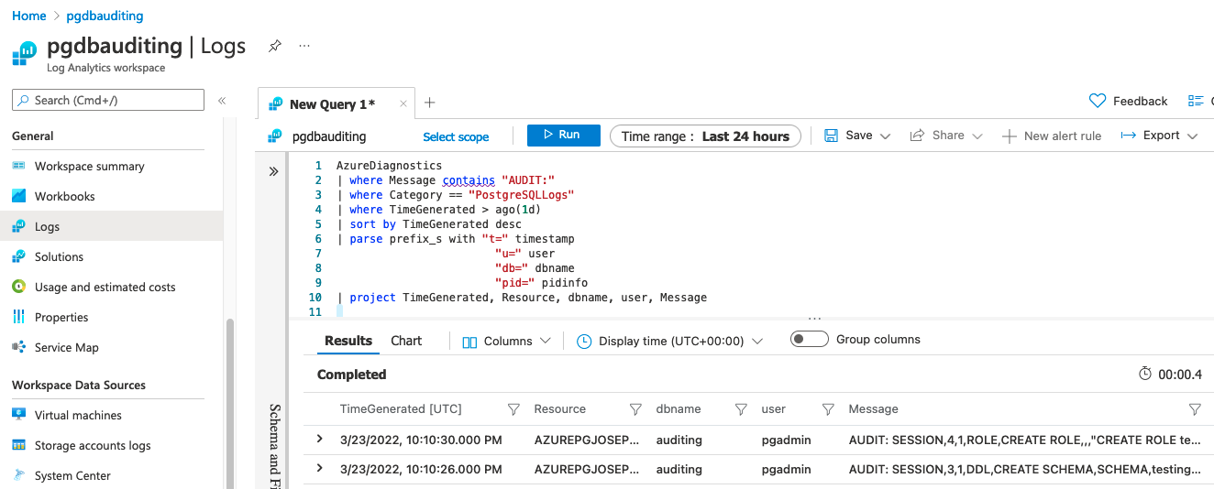
View AZURE monitor logs
Notes:
Here’s what it looks like when you execute that kusto query.
Note it can take a while to get into the log analytics workspace esp after you first set it up, so just keep that in mind.

Slide 21
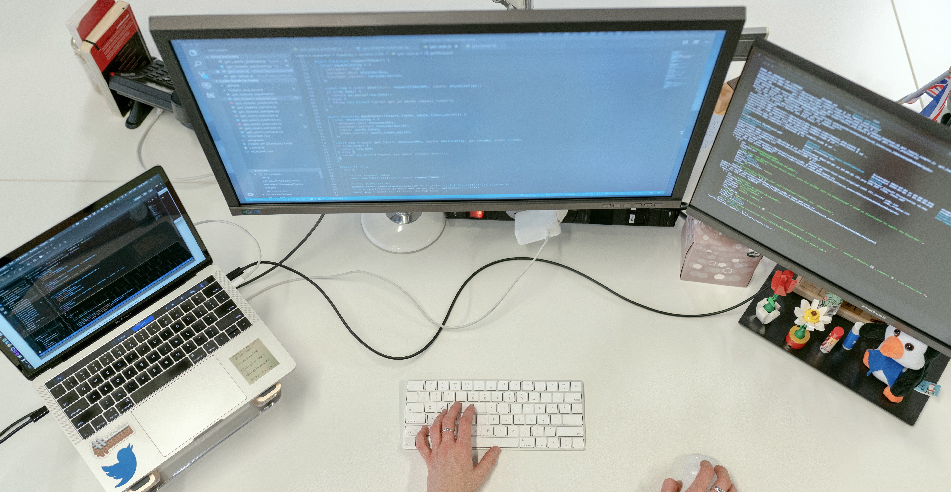
Azure postgresql AUDITING DEMO

Slide 22
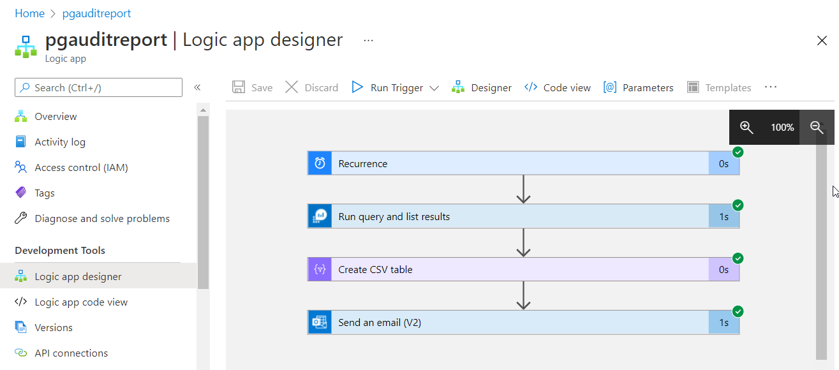
Reporting on Auditing data
Notes:
Here’s the logic app I mentioned to report on your auditing data. It’s a basic workflow and let’s go through the steps in a bit of detail.

Slide 23
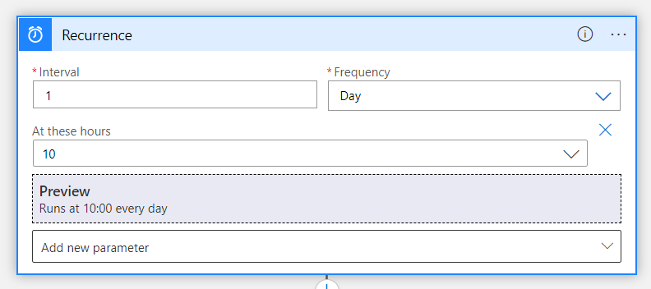
Setup logic app - Recurrence
Setup a schedule with Recurrence step
Notes:
Daily recurrence set so I will receive an email every day with any audited changes

Slide 24
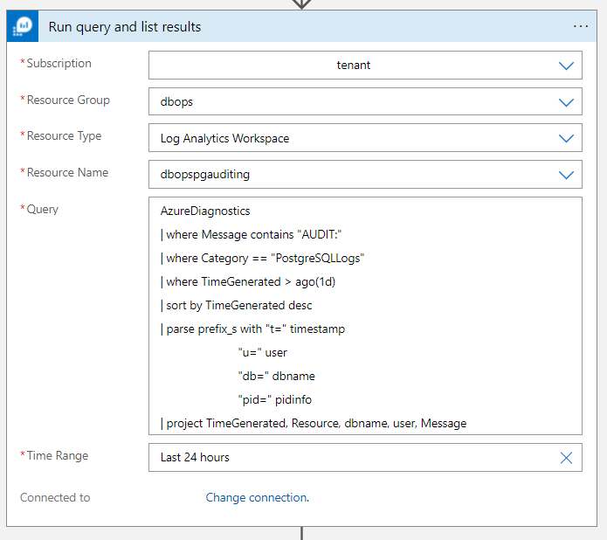
setup logic app –kusto query
Setup a Run query and list results step with your kusto query
Notes:
Then we drop our kusto query into a run query and list results step

Slide 25
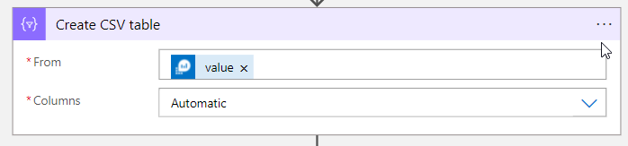
setup logic app – csv file
Create CSV table step to create a CSV file attachment
Notes:
And create csv table bc it’s a pain to format html into the email body

Slide 26
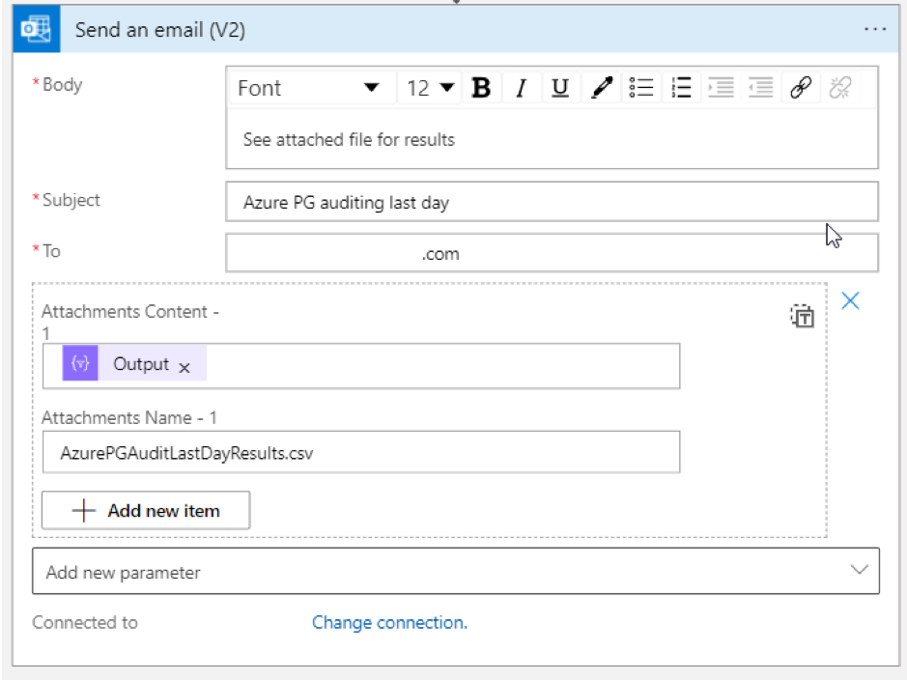
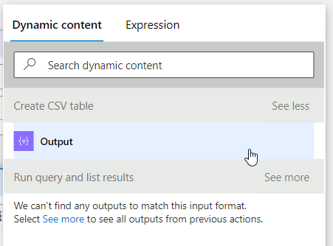
setup logic app – send email
Setup an Outlook Send an Email step to send an email with the CSV attachment
Notes:
Send email with the csv attachment

Slide 27
Resources
Azure Postgres Auditing – Single server
Logs in Azure Database for PostgreSQL
https://docs.microsoft.com/en-us/azure/postgresql/concepts-audit
https://docs.microsoft.com/en-us/azure/postgresql/concepts-server-logs
Azure PostgreSQL Auditing – Flexible server
Configure and access Azure Database for PostgreSQL - Single Server logs from the Azure portal
https://docs.microsoft.com/en-us/azure/postgresql/flexible-server/concepts-audit
https://docs.microsoft.com/en-us/azure/postgresql/howto-configure-server-logs-in-portal
Azure PostgreSQL Auditing – Hyperscale (Citus)
https://docs.microsoft.com/en-us/azure/postgresql/hyperscale/concepts-audit
Get started with log queries in Azure Monitor
https://docs.microsoft.com/en-us/azure/azure-monitor/logs/get-started-queries
Quickstart: Create Azure Logic Apps in the Azure portal
pgaudit.log options explained
https://docs.microsoft.com/en-us/azure/logic-apps/quickstart-create-first-logic-app-workflow
https://github.com/pgaudit/pgaudit/blob/master/README.md#pgauditlog

Slide 28

THANK YOU FOR ATTENDING
Contact me @hellosqlkitty or visit me at sqlkitty.com

